Slide 1
DOELAP Assessor Training Putting It All Together – Site Recommendations
Idaho Falls, ID
September 2023

Slide 2
General Order of the DOELAP Process
Application (with DOE Field Element concurrence)
Performance testing
On-site assessment
Corrective Action Plan – the applicant’s response to the on-site assessment (if required)
DOE field element concurrence to the response
STM review of the on-site assessment and the response
Any other documents deemed necessary
The STM prepares evidence for granting DOELAP accreditation
Oversight Board
Accreditation

Slide 3
Preparation of Site Accreditation Recommendation Packages
The evidence is assembled into an accreditation package for each applicant in the test session
The site accreditation package includes:
The STM letter of recommendation (or not)
Application
Performance testing results
On-site assessment report
Response to the assessment report (if required); STM must receive the corrective action plan within 45 calendar days of assessment’s exit briefing

Slide 4
Oversight Board Review of The Recommendation Packages
Each OSB member is provided the package for review prior to the OSB meeting
Each section of the package is reviewed with time provided for discussion of each section
Questions may be asked of the STM as needed
Final discussions and opinions are presented at the end of the package review
OSB members concur with the STM recommendation, concur with contingencies, or may disagree with STM recommendation
OSB members recuse themselves from voting on their own site

Slide 5
Granting Accreditation
The DOELAP Administrator issues a Certificate of Accreditation and the Conditions of Accreditation
Certificate of Accreditation
Issued to recognize the accreditation of the dosimetry program
Names the accredited program and the effective dates of the accreditation
DOELAP Administrator’s signature
Only the DOELAP Administrator can grant DOELAP accreditation

Slide 6
Granting Accreditation

Slide 7
Granting Accreditation
Conditions of Accreditation
Issued along with the Certificate of Accreditation
Lists the performance testing subcategories, the dosimeters, and dosimetry processing systems that are being accredited for use
Includes the effective end date
DOELAP accreditation typically expires three years from the effective date

Slide 8
Granting Accreditation

Slide 9
Granting Accreditation
DOELAP wants successful applicants, i.e., dosimetry programs
The assessment report and the input provided by assessors is critical
Failure is an option
DOELAP accreditation is not a gift

Slide 10
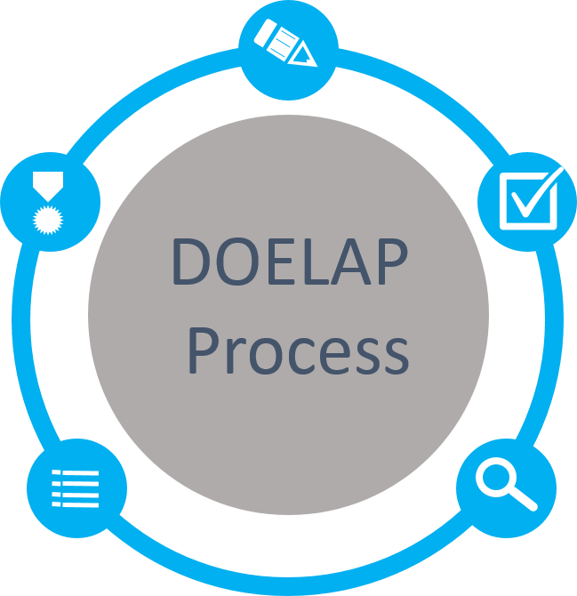
Application
Quality Assurance Program
Field Office Review
Performance Testing
ANSI N13.11, Personnel Dosimetry Performance Criteria and Testing
ANSI N13.32, Performance Testing for Extremity Dosimeters
ANSI N13.30, Performance Criteria for Radiobioassay
Accreditation
Period of 3 years
Notify DOELAP of changes
Oversight Board Review
Complete Package
Recommendations to Administrator
On-Site Assessment
Direct observation and evaluation
Conducted by technical experts

Slide 11
Questions?

